Slide 1
AirWare – Real-Time Air Quality Monitoring System
Milestone: 75% Completion
Team 3
Name: Joseph Alvis Sajith

Slide 2
Introduction
AirWare aims to provide real-time air quality insights.
The system collects and displays AQI, PM2.5, PM10,S02 and NO2 levels.
Designed to help users stay informed about pollution levels in their area and make informed decisions to stay healthy.

Slide 3
Project Objectives
Provide real-time air quality monitoring.
Visualize pollution trends.
Predict AQI using ML model.
Maintain past data history.
Make an user-friendly dashboard.
Provide suggestions based on air quality ofthe area.

Slide 4
Primary Objectives Completed (100%)
Connected the backend to the frontend dashboard.
Connected the charts to the backend.
Implemented a compare feature.
Implement a chatbot using Groq Ai.
Trained a ML model to predict the AQI.

Slide 5
Tech Stack
Backend
Python
Flask Framework
Pandas
GroqAI
Machine Learning
Scikit-learn
Random forest regression
Other Tools Used
Git & GitHub
VS Code

Slide 6
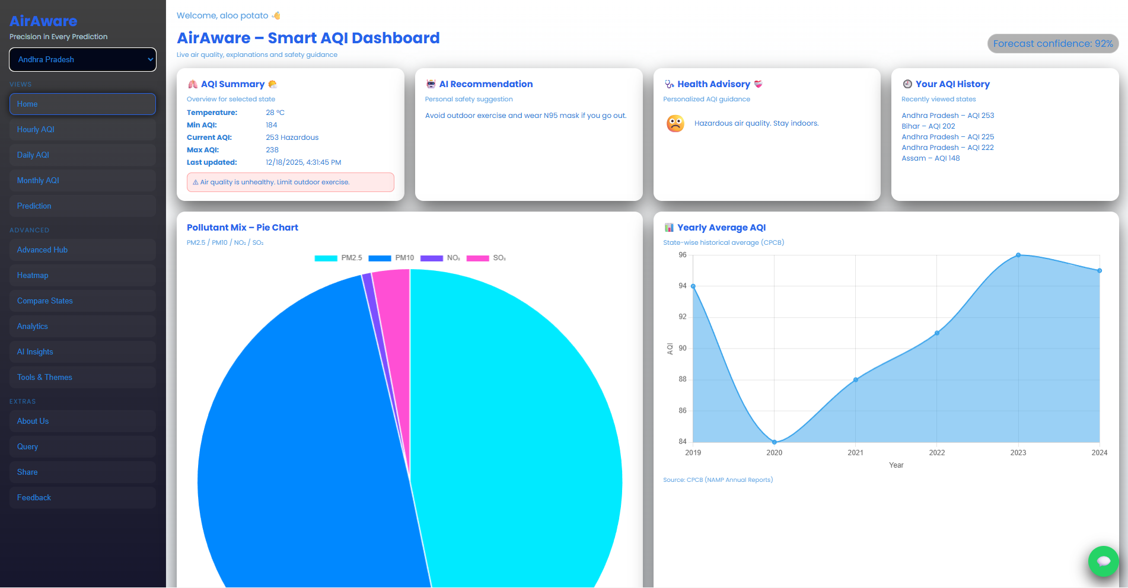
Dashboard

Slide 7
Data Acquisition
The daily and hourly data is being fetched from openweather api.
The yearly and monthly data is taken from CPCB website and is stored in the backend.
The accurate AQI is predicted by the ML model using the PM2.5,PM10,SO2,NO2 values fetched from openweather api.
The AQI forecast of next 2 days is done by the ml model using the PM2.5,PM10,SO2,NO2 values fetched from openweather api.

Slide 8
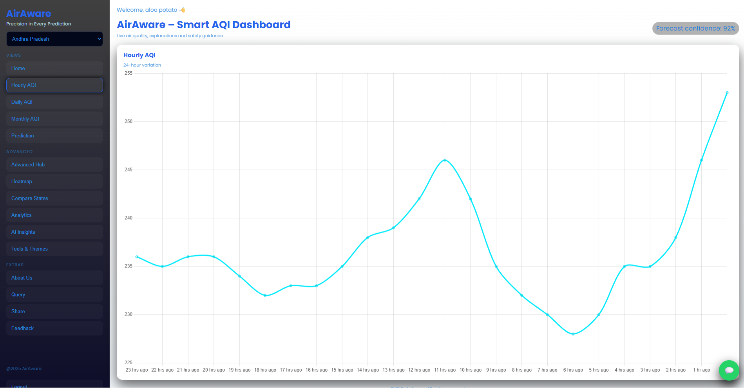
AQI Hourly Chart

Slide 9
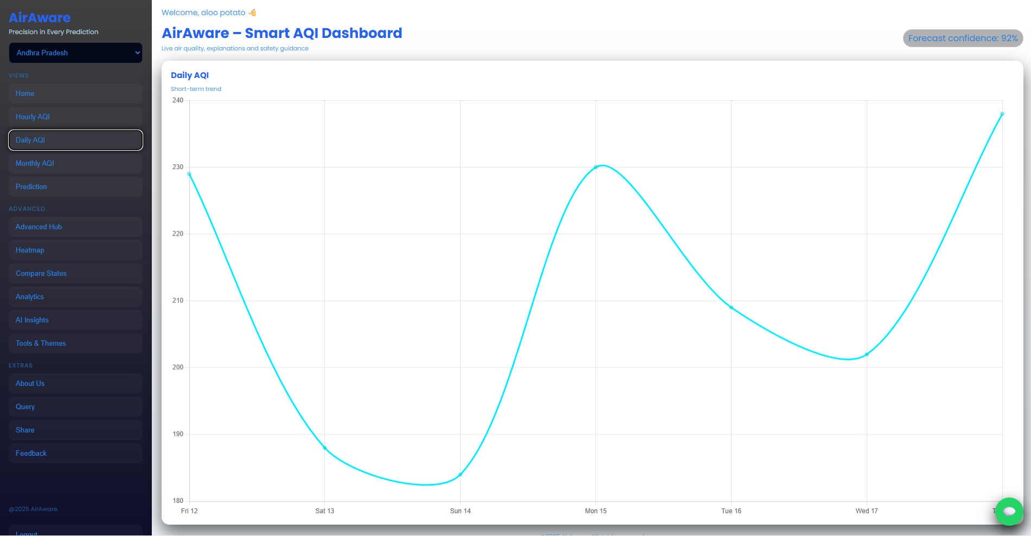
AQI Daily Charts

Slide 10
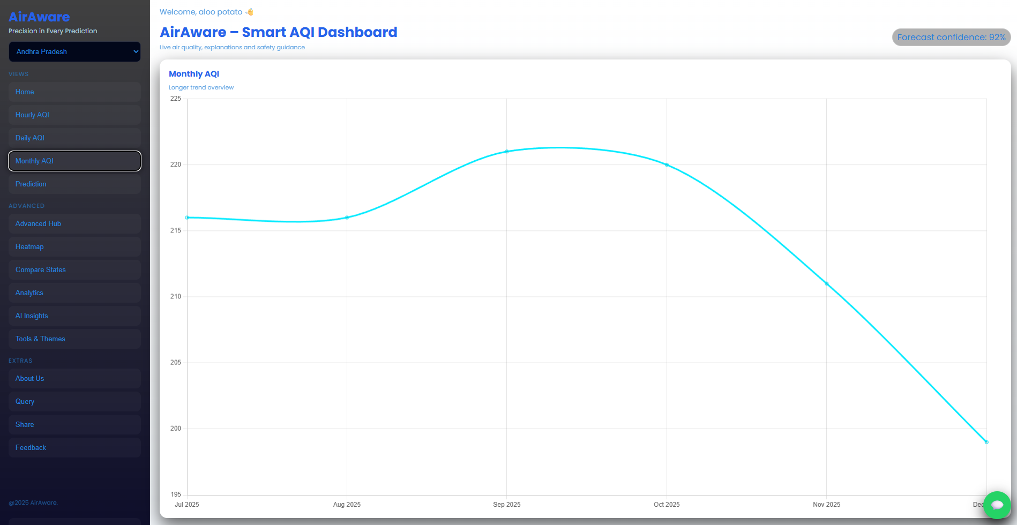
Monthly Avg AQI Chart

Slide 11
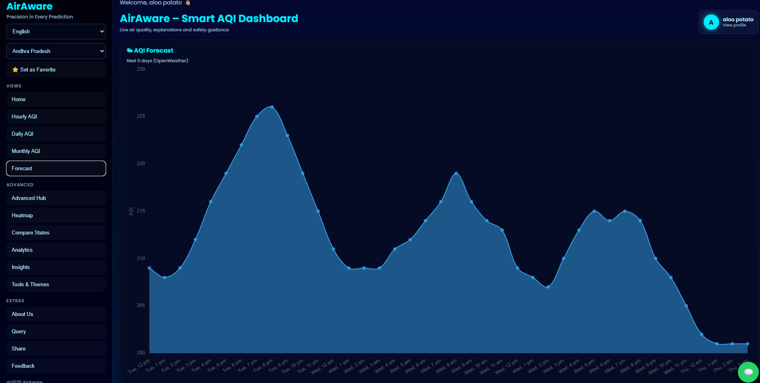
AQI forecast of next 2 days

Slide 12
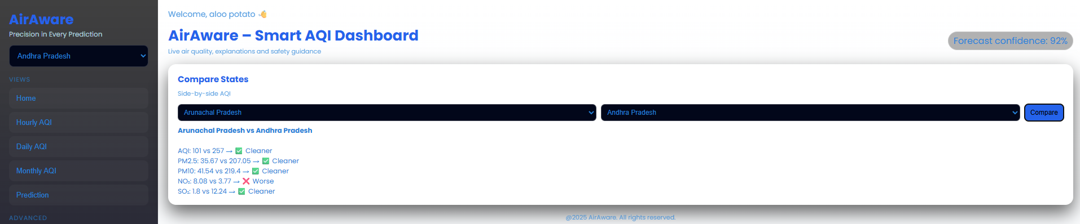
Compare States page

Slide 13
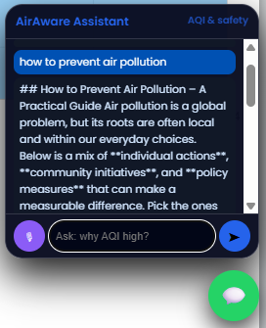
Chatbot Interface
The chatbot is implemented using Groq AI.
The chatbot can help user clarify their doubts.

Slide 14
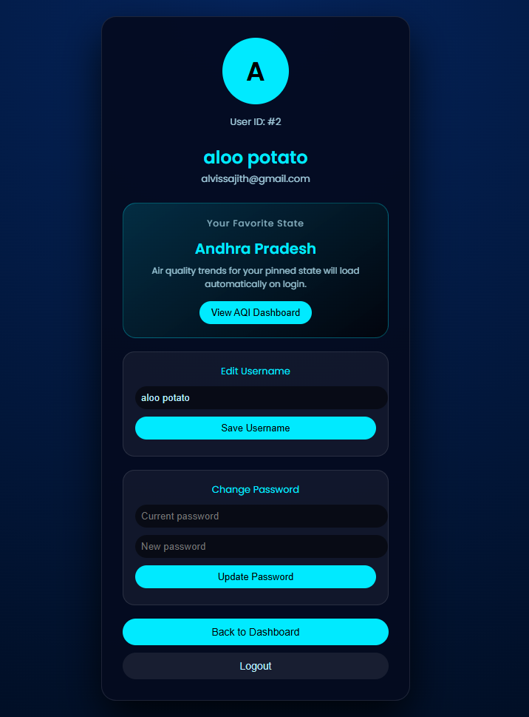
Profile page
User details are displayed here
User can can change their username and password here.

Slide 15
Backend
Flask server created.
API endpoint sends air quality data and GroqAI response to the React frontend.
Real-time Air quality data is being fetched from openweather api and CPCB.
Prediction of AQI is done by the ML model.

Slide 16
ML model
Random Forest Regression Model
  Used to predict AQI based on pollutant parameters.
  Trained using Real-Time Air Quality Index (AQI) India 2023–2025(kaggle).
RMSE: 6.022590979327017
R² Score: 0.9956362792307866

Slide 17
Conclusion
The AirWare project successfully integrates web technologies and machine learning to monitor and analyze air quality.
A complete system was developed with real-time AQI visualization, predictive modeling, AI chatbot support, and user feedback handling.
The Random Forest model achieved high accuracy, demonstrating reliable AQI prediction capability.

Slide 18
Thank You

